Slide 1

String, Math, Formatter

Slide 2
Agenda
In this session, you will learn about:
Strings
Identifying Length of String
String Comparing
Searching within String
Replacing String
Math Functions
Formatting Strings

Slide 3

Building blocks
Strings

Slide 4
String Handling
String Constructors
The String class supports several constructors.
To create an empty String, you call the default constructor.
For example,
will create an instance of String with no characters in it
String s = new String();

Slide 5
String Handling
String Constructors - Example
char characters[] = { 'J', 'a', 'v', 'a' };
String string1 = new String(characters);
String string2 = new String(string1);
System.out.println(string1);
System.out.println(string2);
Notes:
semester2\1-java8\2-arrays-strings-collections-generics\2-class-exercises-and-demos\arrays-strings-collections-generics\src\com\imarticus\tutorial\arraystringcollectiongenerics\demos\stringmathformatter\MakeString.java

Slide 6
Building blocks
Identifying Length of String

Slide 7
String Handling
String Length
The length of a string is the number of characters that it contains.
To obtain this value, call the length( ) method,
The following fragment prints “3”, since there are three characters in the string str:
char characters[] = { 'a', 'b', 'c' };
String str = new String(characters);
System.out.println(str.length());
Notes:
semester2\1-java8\2-arrays-strings-collections-generics\2-class-exercises-and-demos\arrays-strings-collections-generics\src\com\imarticus\tutorial\arraystringcollectiongenerics\demos\stringmathformatter\StringLengthDemo.java

Slide 8
String Operations
String Literals
String literal can be used to initialize a String object.
For example, the following code fragment creates two equivalent strings:
Convert a string back to character array by calling method toCharArray(), so that we can iterate each characters.
It calls the length( ) method on the string “abc”.
As expected, it prints “3”.
char chars[] = { 'a', 'b', 'c' };
String s1 = new String(chars);
String s2 = "abc";
char chararray[] = s2.toCharArray()
System.out.println("abc".length());

Slide 9
String Operations
String Conversion
Every class implements toString( ) because it is defined by Object.
However, the default implementation of toString( ) is seldom sufficient.
The toString( ) method has this general form:
To implement toString( ), simply return a String object that contains the human-readable string that appropriately describes an object of your class.
String toString( )

Slide 10
String Operations
Override toString() method for any object
// Override toString() for Box class.
class Box {
double width;
double height;
double depth;
Box(double w, double h, double d) {
width = w;
height = h;
depth = d;
}
public String toString() {
return "Dimensions are " + width + " by " + depth + " by " + height + ".";
}
}
Notes:
semester2\1-java8\2-arrays-strings-collections-generics\2-class-exercises-and-demos\arrays-strings-collections-generics\src\com\imarticus\tutorial\arraystringcollectiongenerics\demos\stringmathformatter\ObjectConcatenationDemo.java
Continued next slide

Slide 11
String Operations
Override toString() method for any object
Box box = new Box(10, 12, 14);
String str = "Box b: " + box; // concatenate Box object
System.out.println(box); // convert Box to string
System.out.println(str);
As the object returns string because of its toString() method, we can concatenate with other string.
Notes:
semester2\1-java8\2-arrays-strings-collections-generics\2-class-exercises-and-demos\arrays-strings-collections-generics\src\com\imarticus\tutorial\arraystringcollectiongenerics\demos\stringmathformatter\ObjectConcatenationDemo.java

Slide 12
Building blocks
String Comparing

Slide 13
String Comparison
equals( ) and equalsIgnoreCase( )
String helloTxt = "Hello";```````````````````````````````````````````````
String anotherHelloTxt = "Hello";
String goodByeTxt = "Good-bye";
String upperCaseHelloTxt = "HELLO";
System.out.println(helloTxt + " equals " + anotherHelloTxt + " -> " + helloTxt.equals(anotherHelloTxt));
System.out.println(helloTxt + " equals " + goodByeTxt + " -> " + helloTxt.equals(goodByeTxt));
System.out.println(helloTxt + " equals " + upperCaseHelloTxt + " -> " + helloTxt.equals(upperCaseHelloTxt));
System.out.println(helloTxt + " equalsIgnoreCase " + upperCaseHelloTxt + " -> " + helloTxt.equalsIgnoreCase(upperCaseHelloTxt));
Notes:
semester2\1-java8\2-arrays-strings-collections-generics\2-class-exercises-and-demos\arrays-strings-collections-generics\src\com\imarticus\tutorial\arraystringcollectiongenerics\demos\stringmathformatter\StringEqualsDemo.java

Slide 14
String Comparison
contains()
The contains( ) method checks if substring exists in parentString
String sentence = "Hello Boss";
String helloTxt = "Hello";
System.out.println(sentence + " contains " + helloTxt + " -> " + sentence.contains(helloTxt));
Notes:
semester2\1-java8\2-arrays-strings-collections-generics\2-class-exercises-and-demos\arrays-strings-collections-generics\src\com\imarticus\tutorial\arraystringcollectiongenerics\demos\stringmathformatter\StringContainsDemo.java

Slide 15
String Comparison
startsWith() and endsWith()
String defines two routines that are, more or less, specialized forms of regionMatches( ). The startsWith( ) method determines whether a given String begins with a specified string. Conversely, endsWith( ) determines whether the String in question ends with a specified string.
Here, str is the String being tested. If the string matches, true is returned. Otherwise, false is returned.
boolean startsWith(String str)
boolean endsWith(String str)

Slide 16
Strings Handling
Modifying Strings – concat()
You can concatenate two strings using concat( ), shown here:
Also you can use + to concatenate strings
String concat(String str)

Slide 17
Strings Handling
Modifying Strings – replace()
The replace( ) method replaces a subString by another string
String sentence = "Hello Boss";
String searchTxt = "Hello";
String replaceTxt = "Yes";
String replacedSentence =sentence.replace(searchTxt, replaceTxt);
Notes:
semester2\1-java8\2-arrays-strings-collections-generics\2-class-exercises-and-demos\arrays-strings-collections-generics\src\com\imarticus\tutorial\arraystringcollectiongenerics\demos\stringmathformatter\StringReplaceDemo.java

Slide 18
Strings Handling
Modifying Strings – trim()
The trim( ) method returns a copy of the invoking string from which any leading and trailing whitespace has been removed.
Here is an example:
This puts the string “Hello World” into s removing the last whitespace.
String s = " Hello World ".trim();

Slide 19
Strings Handling
Strings – iterate each character
The trim( ) method returns a copy of the invoking string from which any leading and trailing whitespace has been removed.
Here is an example:
This puts the string “Hello World” into s removing the last whitespace.
String s = " Hello World ".trim();

Slide 20
Strings Handling
Exercise
Create a class PalindromeChecker
Check whether a given string is palindrome or not
What is a palindrome string? It is a string that reads the same backward as well as forward
Notes:
semester2\1-java8\2-arrays-strings-collections-generics\2-class-exercises-and-demos\arrays-strings-collections-generics\src\com\imarticus\tutorial\arraystringcollectiongenerics\exercises\stringmathformatter\PalindromeChecker.java

Slide 21
Building blocks
Math

Slide 22
Math
Math Class
The Math class is part of the java.lang package.
The Math class contains methods that perform various mathematical functions.
This include:
absolute value
exponentiation
generate random numbers
square root
trigonometric functions

Slide 23
Math
Math Class
Static methods can be invoked through the class name – no object of the Math class is needed
The methods of the Math class are static methods (also called class methods)

Slide 24
Math
Math Class
Method | Purpose | Argument | Result Type
abs(x) | Returns the absolute value of x | any numeric type | same as argument
ceil(x) | Returns smallest whole number >= x | double | double
exp(x) | Returns ex where e = 2.71828… | double | double
floor(x) | Returns the largest whole number <= x | double | double
log(x) | Returns the natural logarithm of x (base e) for x > 0.0 | double | double

Slide 25
Math
Math Class
Method | Purpose | Argument | Result Type
max(x,y) | Returns the larger of x and y | any numeric type | same as argument
min(x,y) | Returns the smaller of x and y | any numeric type | same as argument
pow(x,y) | Returns xy. An error will occur if x = 0 and y <=0, or x < 0 and y is not a whole number | any numeric type | double
random() | Returns a pseudorandom number between 0.0 and 1.0 | double | double

Slide 26
Math
Math Class
Method | Purpose | Argument | Result Type
max(x,y) | Returns the larger of x and y | any numeric type | same as argument
min(x,y) | Returns the smaller of x and y | any numeric type | same as argument
pow(x,y) | Returns xy. An error will occur if x = 0 and y <=0, or x < 0 and y is not a whole number | any numeric type | double
random() | Returns a pseudorandom number between 0.0 and 1.0 | double | double

Slide 27
Math
Math Class
Method | Purpose | Argument | Result Type
rint(x) | Returns the closest whole number to x | double | double
round(x) | Returns the integer value closet to x | double or float | long or int
sqrt(x) | Returns the positive square root of x for x > 0.0 | double | double

Slide 28
Math
double decimalNumber =20.344545;
double anotherdecimalNumber =20.544545;
int negativeNumber =-4;
int number =6;
System.out.println("Absolute value of " +negativeNumber + " => " +Math.abs(negativeNumber));
//Ceil floor
System.out.println("Ceil value of " +decimalNumber + " => " +Math.ceil(decimalNumber));
System.out.println("Floor value of " +decimalNumber + " => " +Math.floor(decimalNumber));
//Max min
System.out.println("Max value of " +decimalNumber + " another " + anotherdecimalNumber + " => " +
Math.max(decimalNumber,anotherdecimalNumber));
System.out.println("Min value of " +decimalNumber + " another " + anotherdecimalNumber + " => "
+Math.min(decimalNumber,anotherdecimalNumber));
Notes:
semester2\1-java8\2-arrays-strings-collections-generics\2-class-exercises-and-demos\arrays-strings-collections-generics\src\com\imarticus\tutorial\arraystringcollectiongenerics\demos\stringmathformatter\MathFunctionsDemo.java

Slide 29
Building blocks
Formatter

Slide 30
Formatter
Formatting in older versions of Java
Classes such as NumberFormat, DateFormat, and MessageFormat provided by earlier versions of Java do have useful formatting capabilities.
At the core of Java’s support for creating formatted output is the Formatter class.

Slide 31
Formatter
Formatter Constructors
Before using formatter to format output, Formatter object needs to be created.
In general, Formatter works by converting the binary form of data used by a program into formatted text.
It stores the formatted text in a buffer, the contents of which can be obtained by the program whenever they are needed.
It is possible to let Formatter supply this buffer automatically, or can be specified explicitly when a Formatter object is created.
It is also possible to have Formatter output its buffer to a file.
The Formatter class defines many constructors, which enables to construct a Formatter in a variety of ways

Slide 32
Formatter
Formatter Basics
After Formatter has created, it can be used to create a formatted string.
To do so, the format( ) method can be used.
The most commonly used version is shown here:
Formatter format(String fmtString, Object ... args)

Slide 33
Formatter
Formatting Strings, Numbers and Characters
Use %c - To format an individual character
This causes the matching character argument to be output, unmodified.
Use %s - To format a string
Use %d - To format an integer in decimal format
Use %f - To format a floating-point value in decimal format.
Use %e - To format a floating-point value in scientific notation.
The %g format specifier causes Formatter to use either %f or %e, whichever is shorter.

Slide 34
Formatter
Demonstration using g% -
Formatter fmt = new Formatter();
for (double i = 1000; i < 1.0e+10; i *= 100) {
fmt.format("%g ", i);
System.out.println(fmt);
}
Notes:
semester2\1-java8\2-arrays-strings-collections-generics\2-class-exercises-and-demos\arrays-strings-collections-generics\src\com\imarticus\tutorial\arraystringcollectiongenerics\demos\stringmathformatter\FormatterDemo.java

Slide 35
Formatter
Formatting Date time will be covered in detail on Date time API Session.

Slide 36

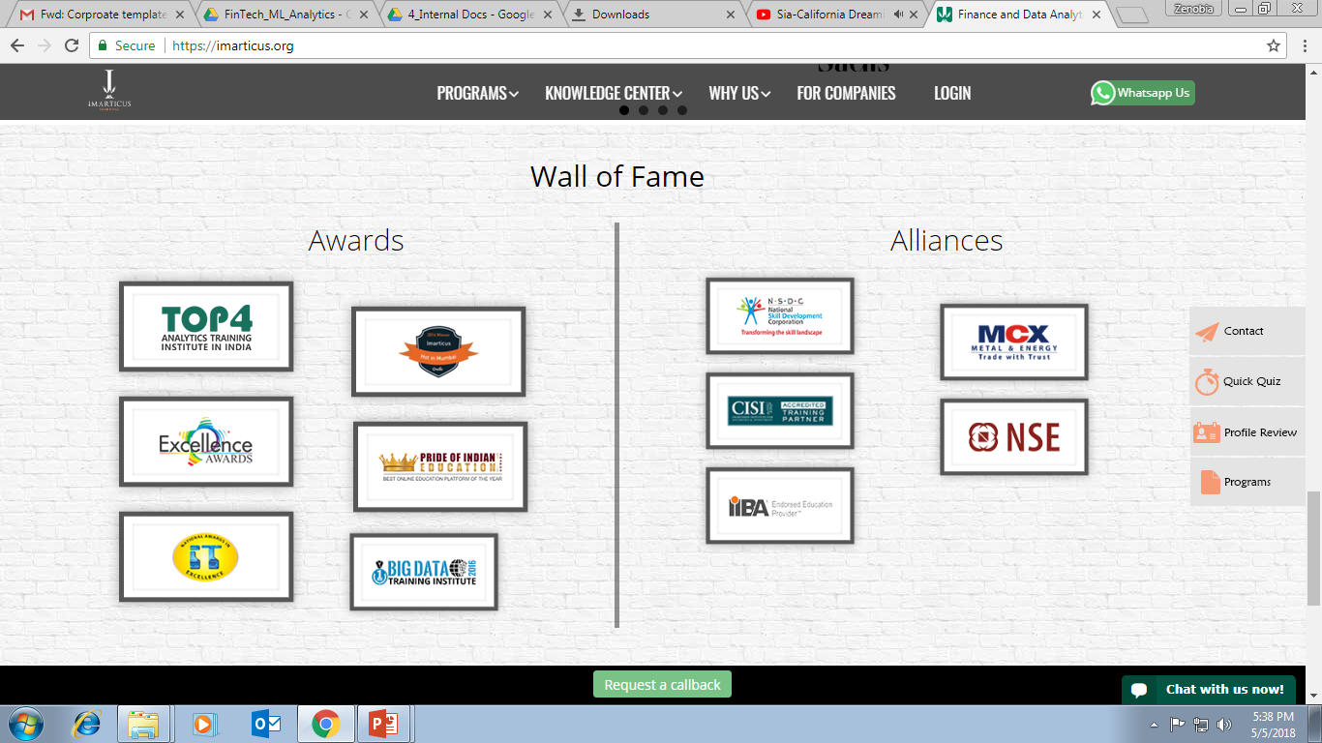



AWARDS:
Learn more:
https://imarticus.org/corporate/
Email us:
info@imarticus.com
Connect with us:
www.linkedin.com/company/imarticuslearning
ACCREDITED TRAINING PARTNER:
Watch us:
www.youtube.com/ImarticusLearninginstitute
Visit us:
Mumbai | Thane | Pune | Bangalore | Delhi - NCR | Hyderabad | Chennai | Coimbatore

